Slide 1

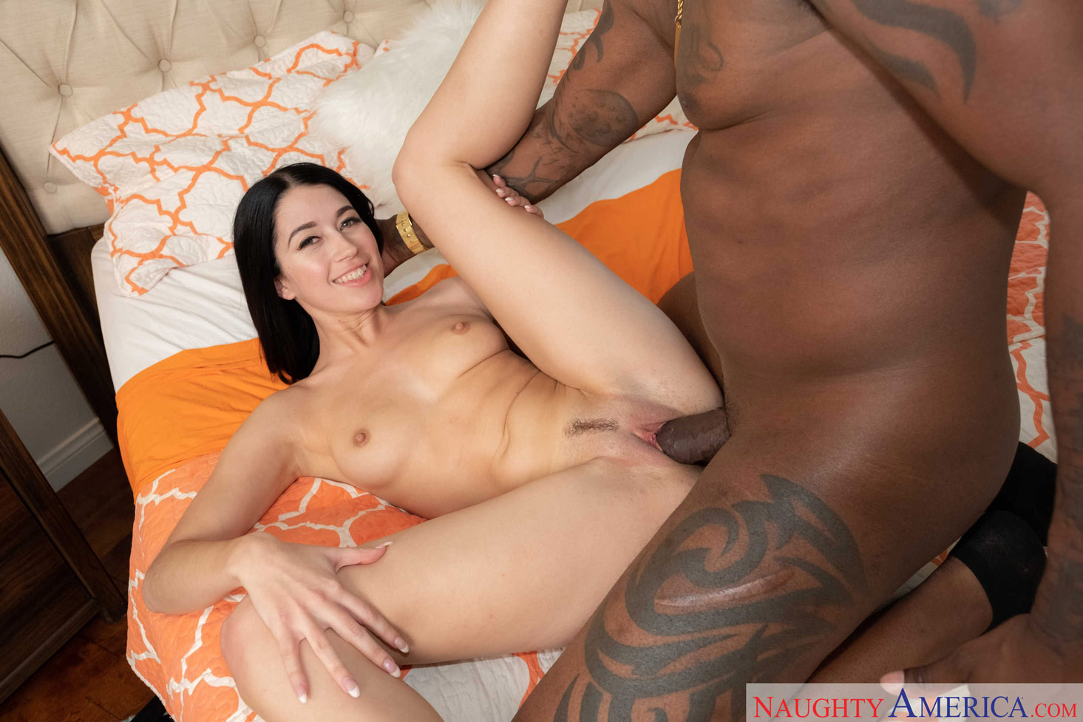
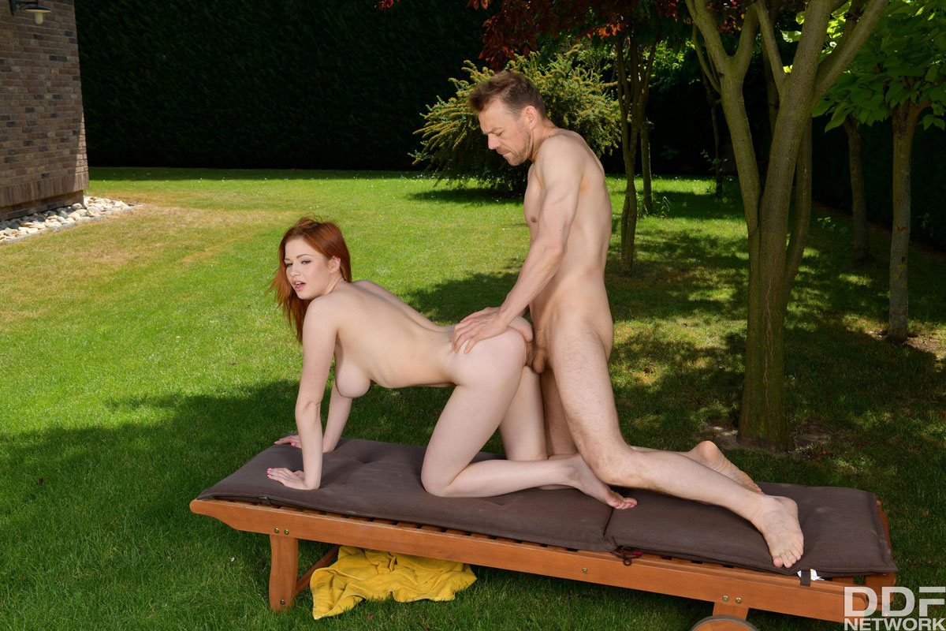



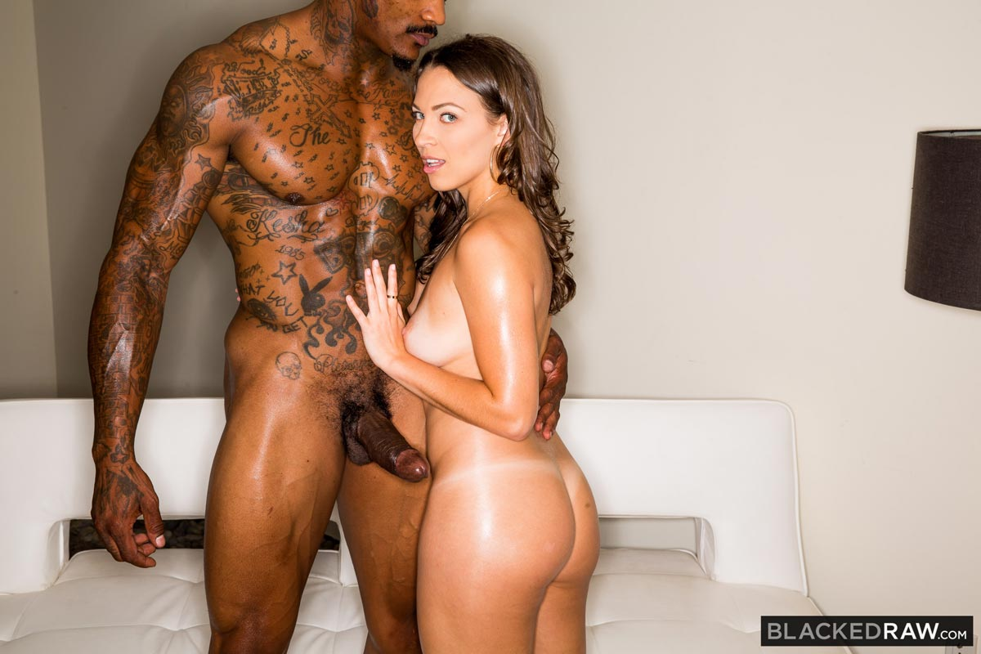
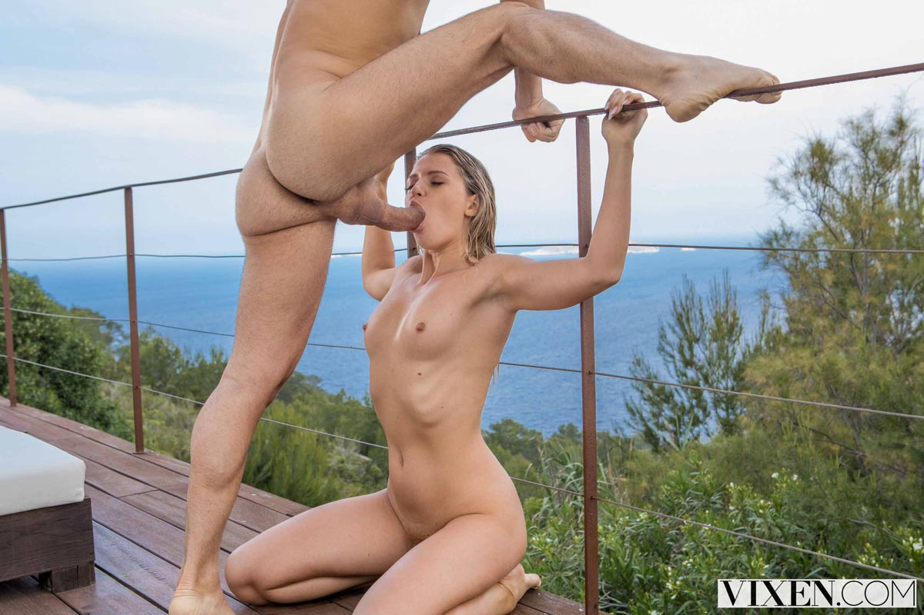
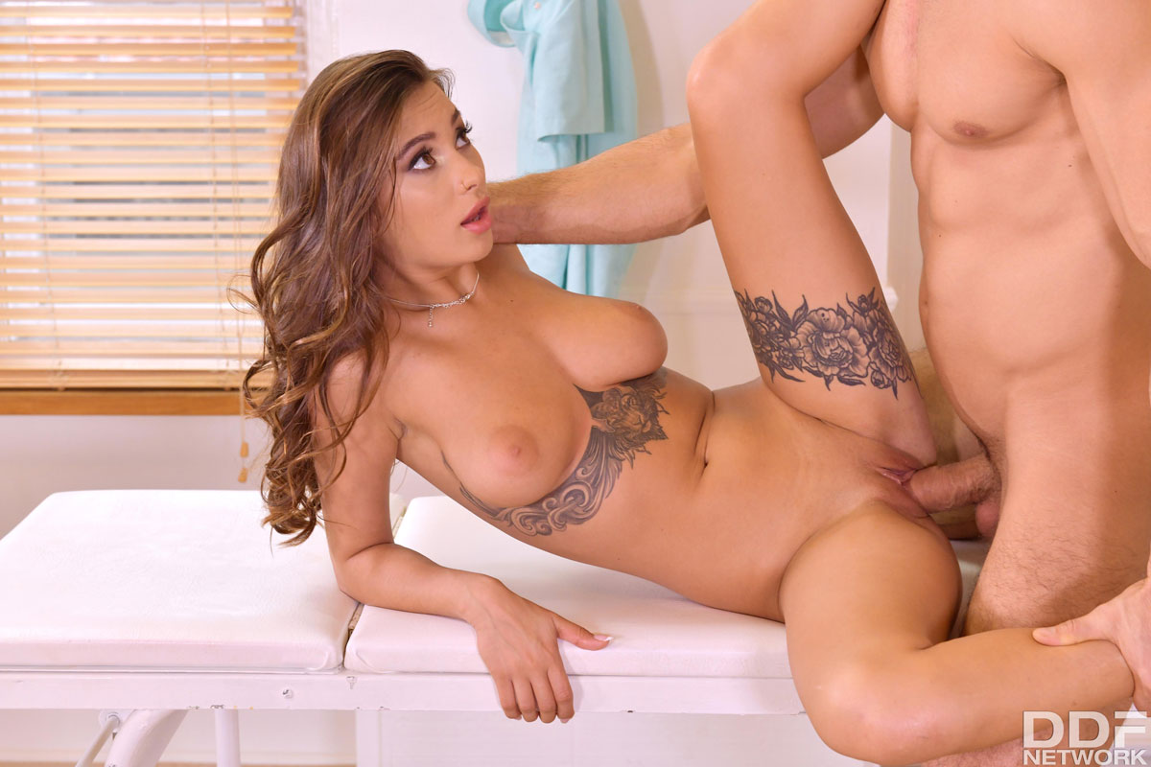
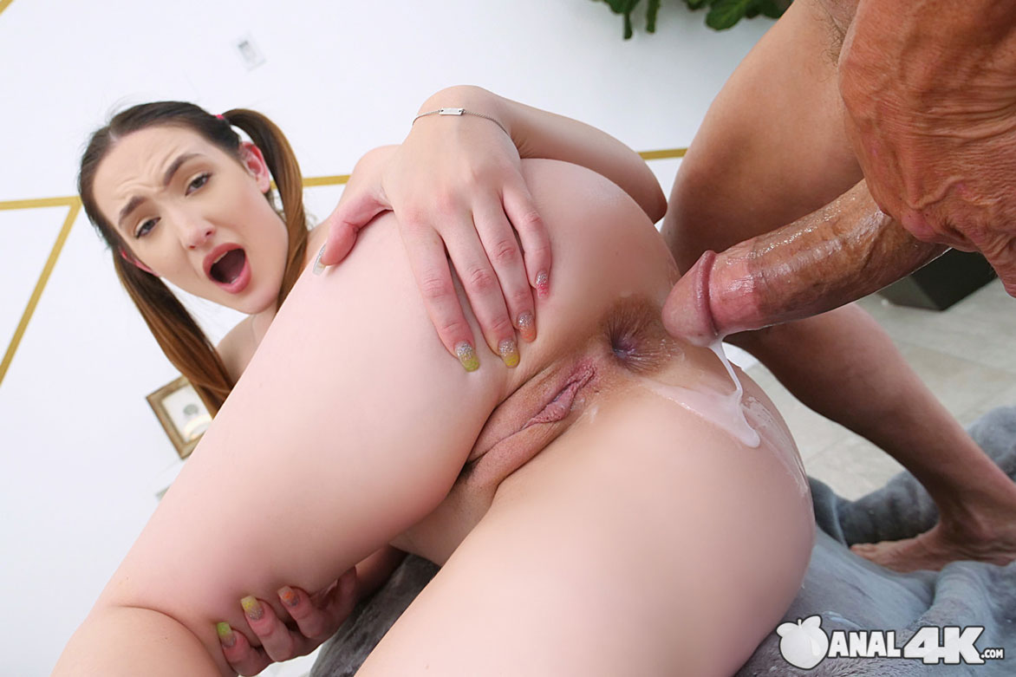
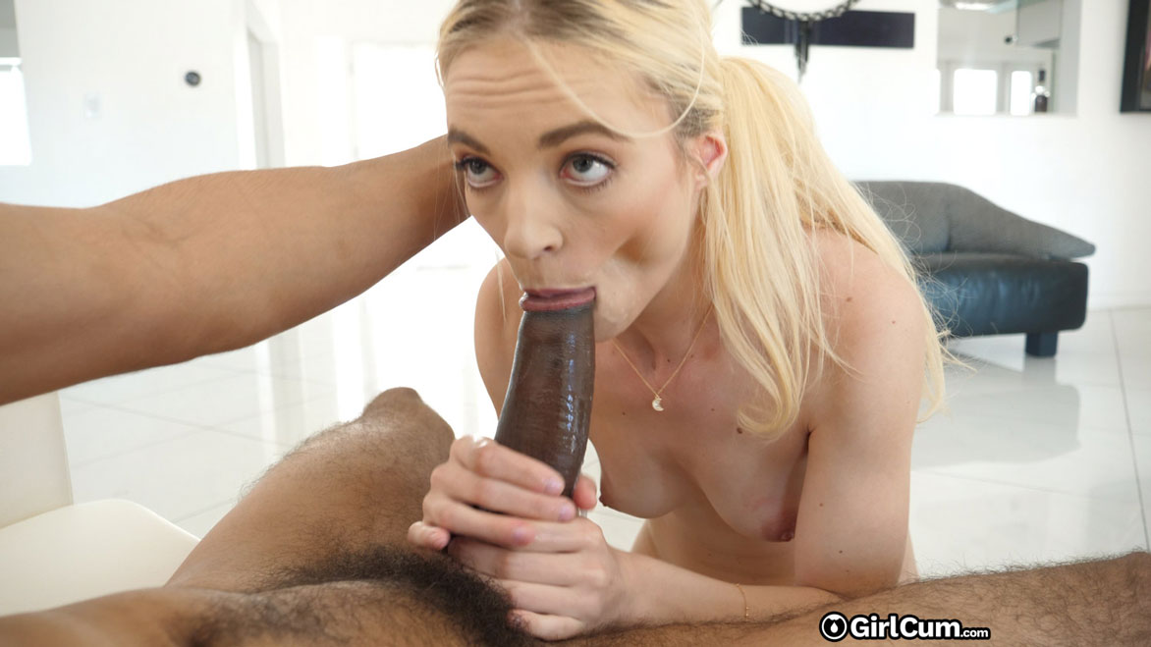
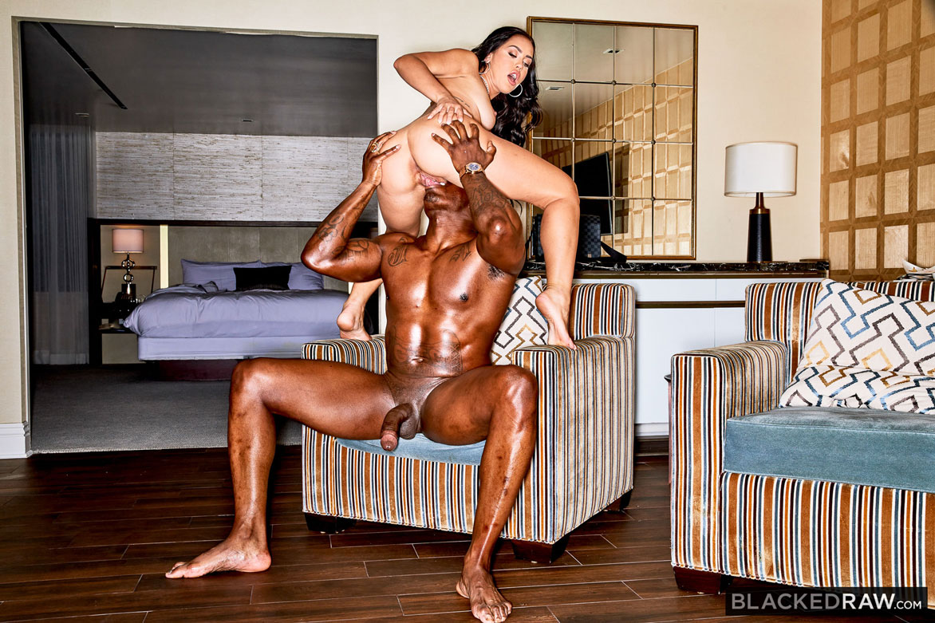
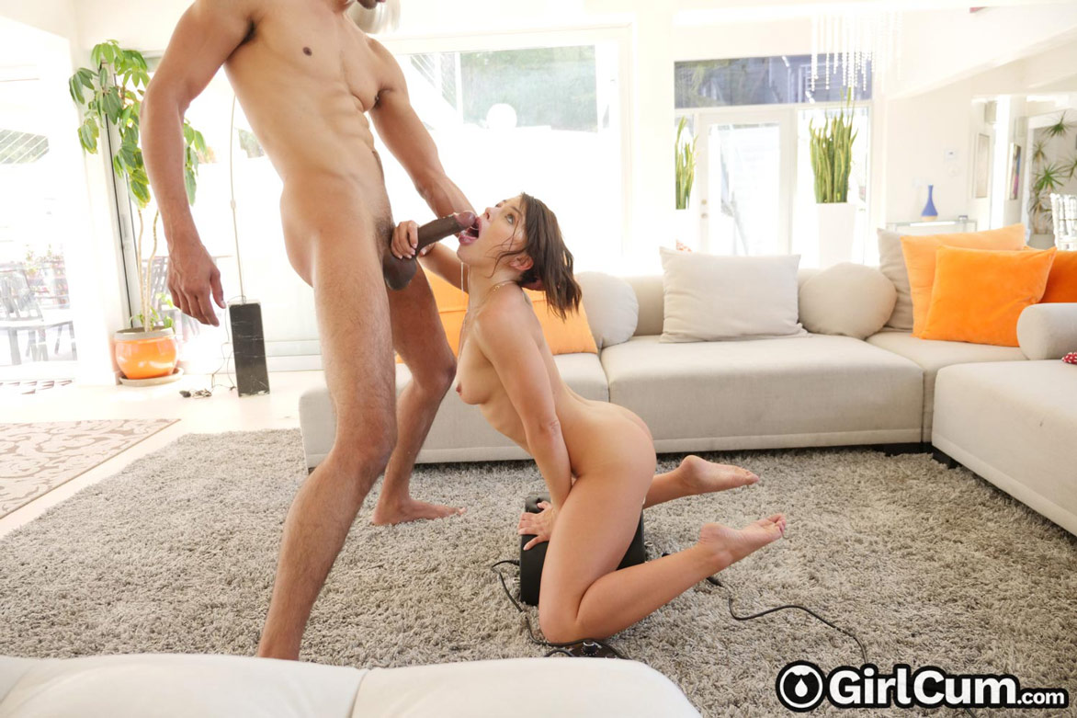
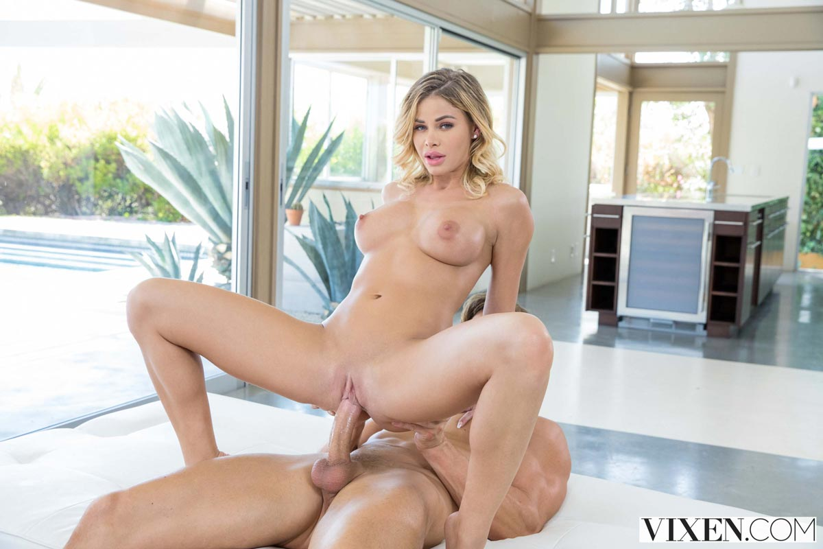
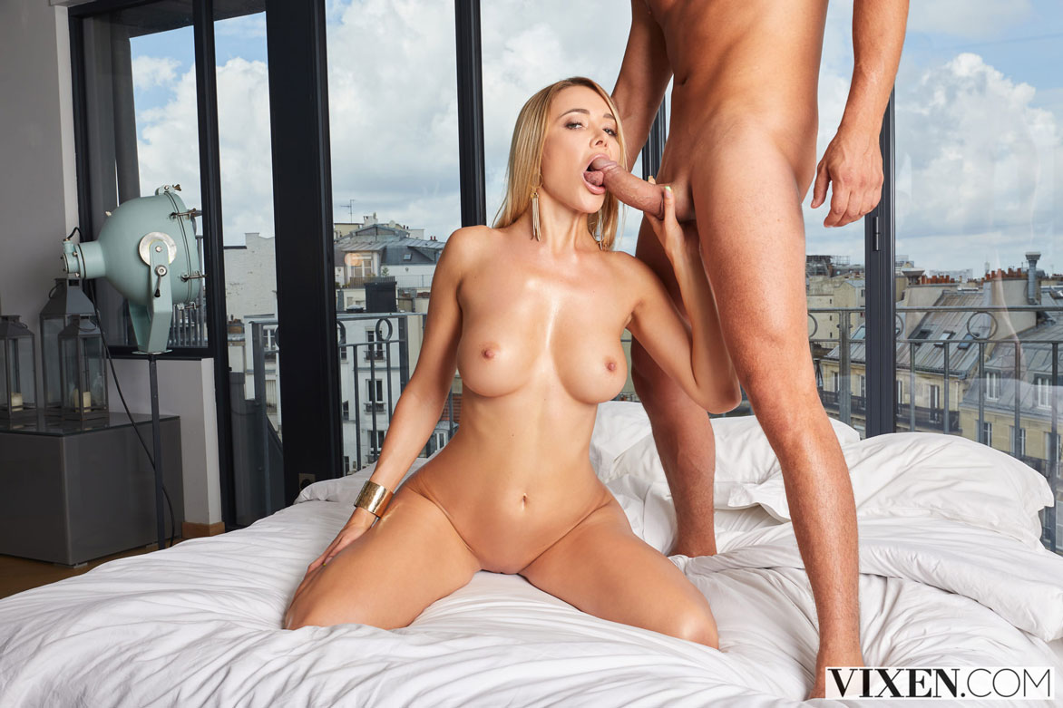
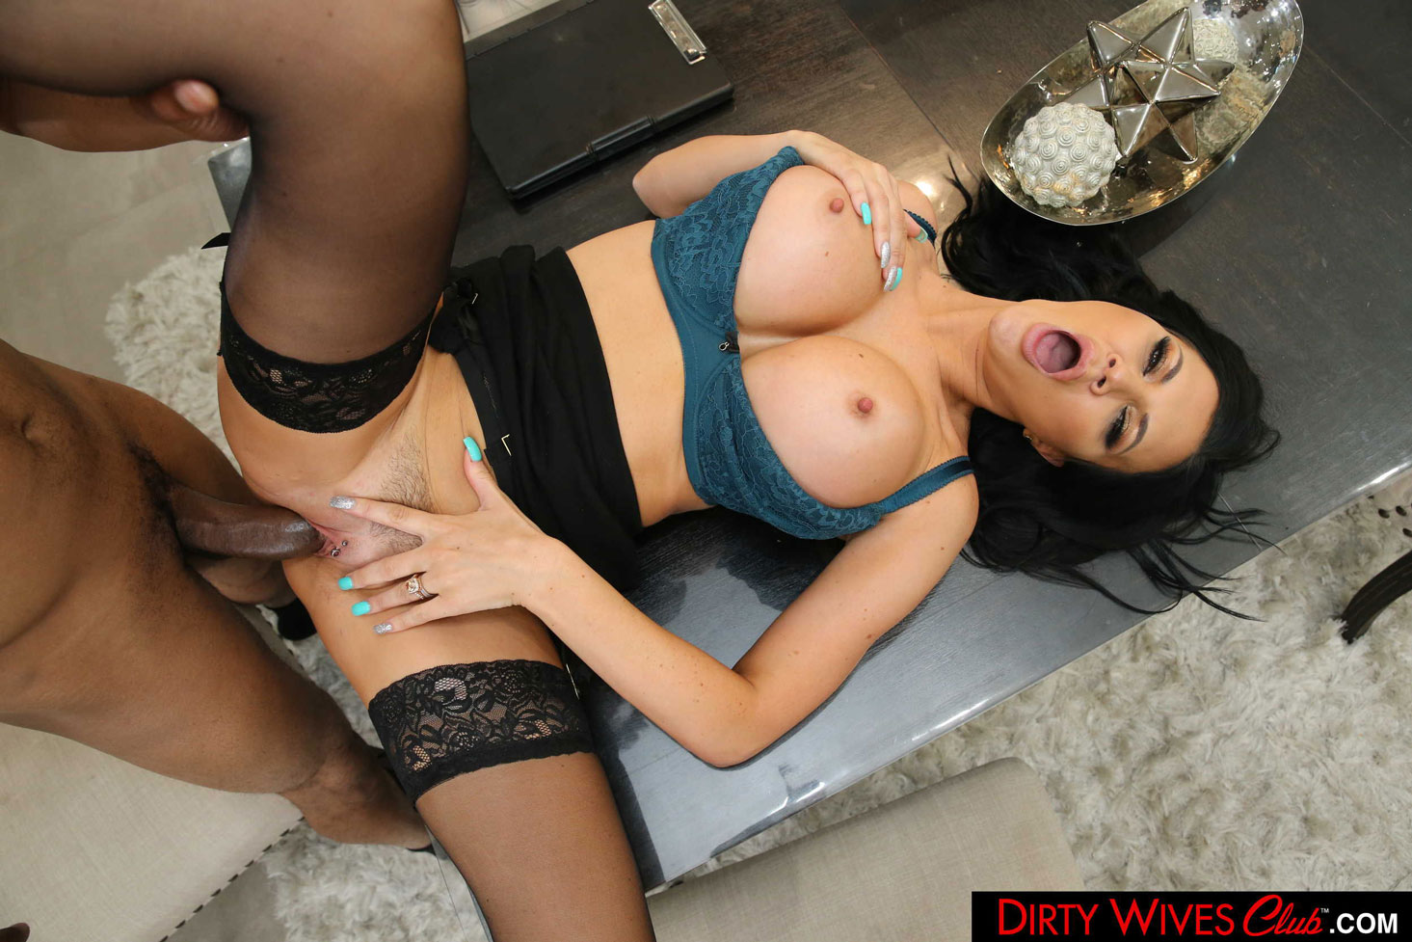
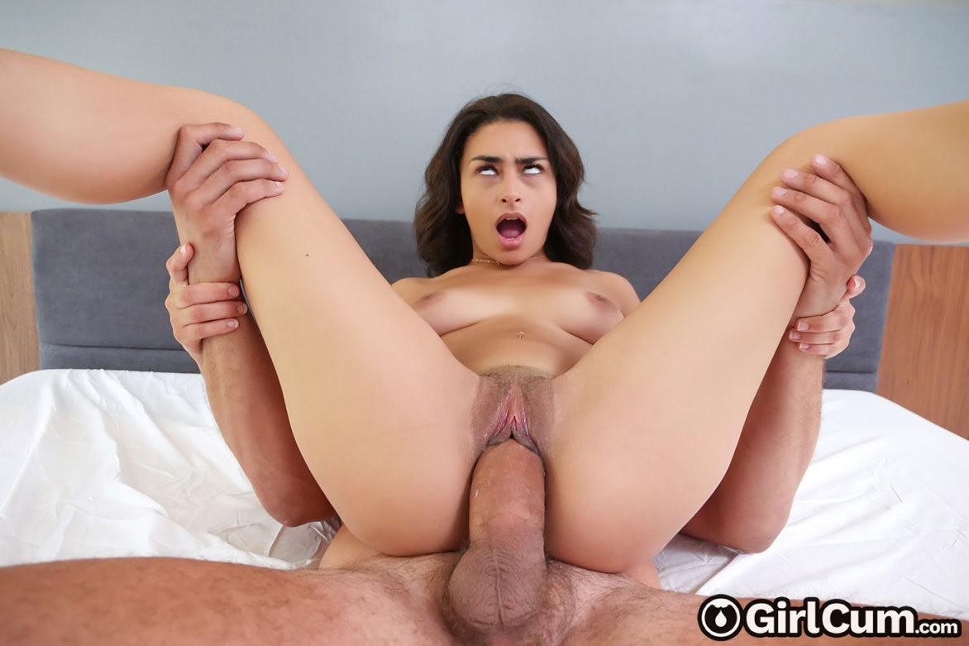
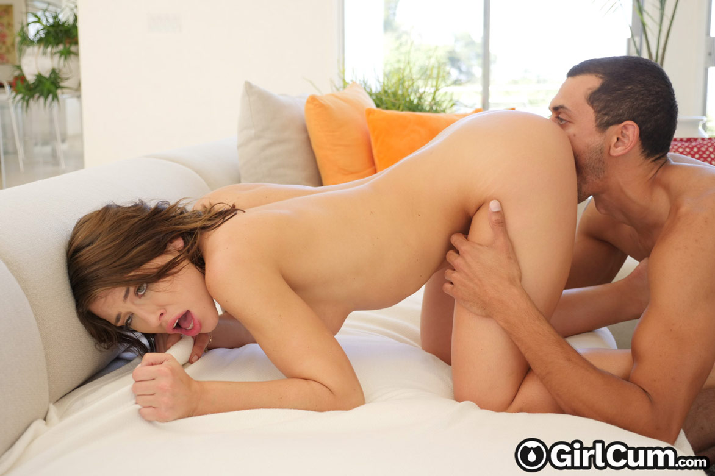
The Babes list
List of The Best Sluts in Porn

Slide 2
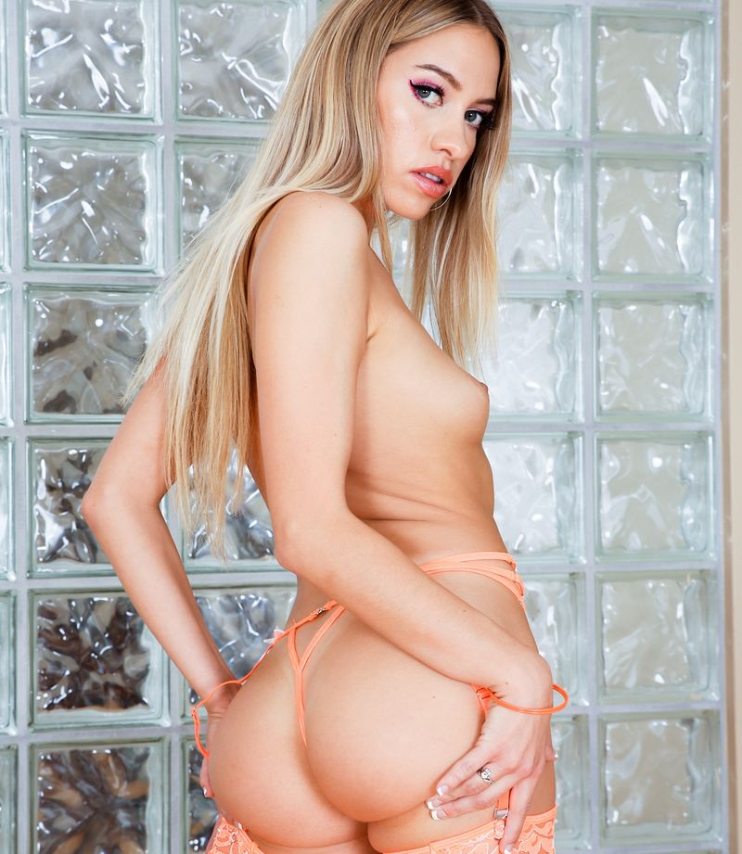
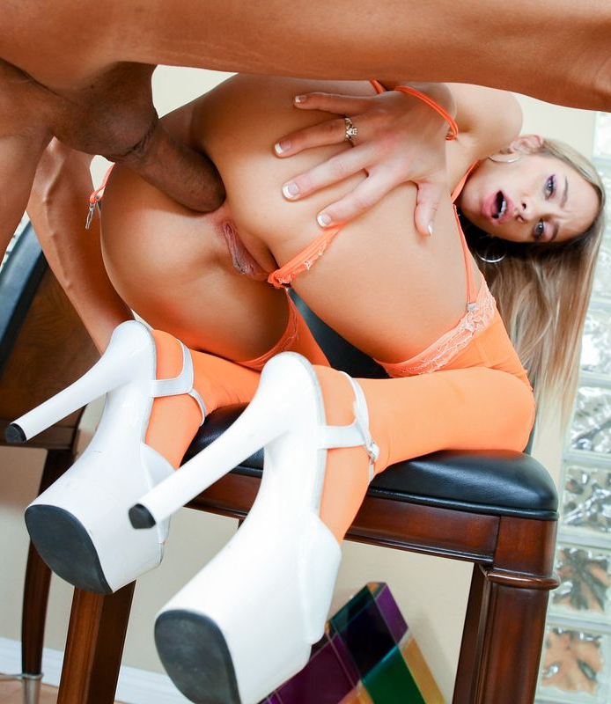
Khloe Kapri
aka Chloe Capri
Age: 24
Height: 160cm
Weight: 49kg
Body Type: Slim
Cup size: 32B
Boobs: Natural
Ethnicity: Caucasian
Years Active: 2016-Present
Rating: 00
The Babes list
List of The Best Sluts in Porn

Slide 3
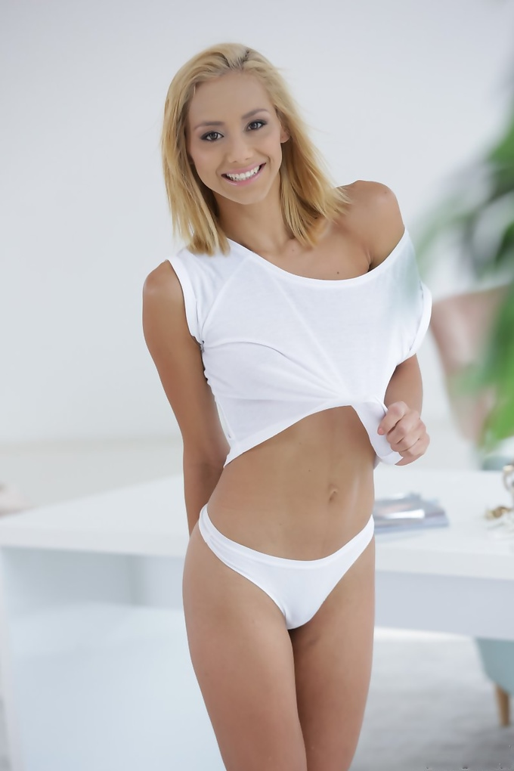
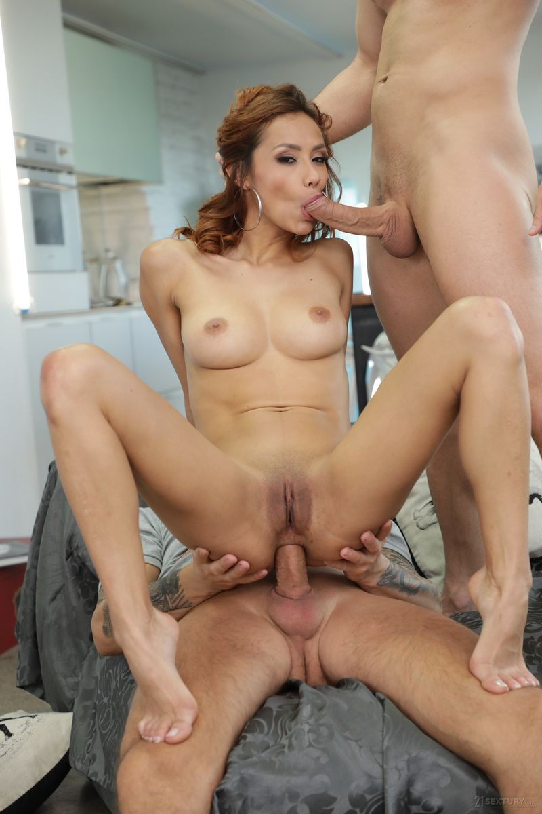
Veronica Leal
aka Veronica Orozco / Veronica A
Age: 24
Height: 162cm
Weight: 45kg
Body Type: Slim
Cup size: 32C
Boobs: Natural
Ethnicity: Latin
Years Active: 2018-Present
Rating: 00
The Babes list
List of The Best Sluts in Porn

Slide 4
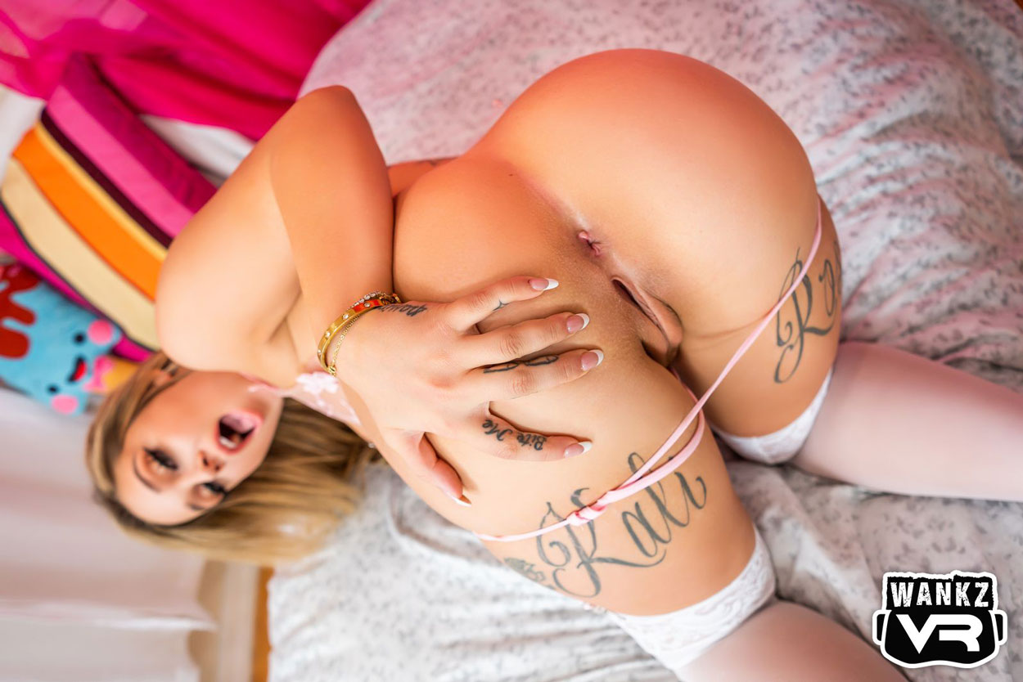
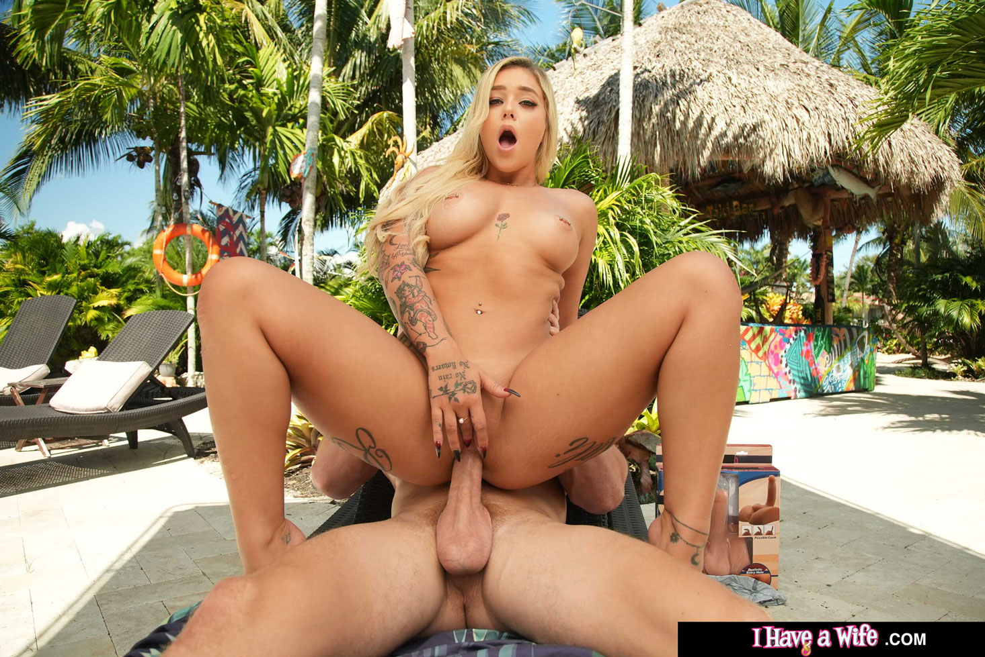
Kali Rose
Kali Roses
Age: 25
Height: 167cm
Weight: 52kg
Body Type: Average
Cup size: 32C
Boobs: Natural
Ethnicity: Caucasian
Years Active: 2016-Present
Rating: 00
The Babes list
List of The Best Sluts in Porn

Slide 5
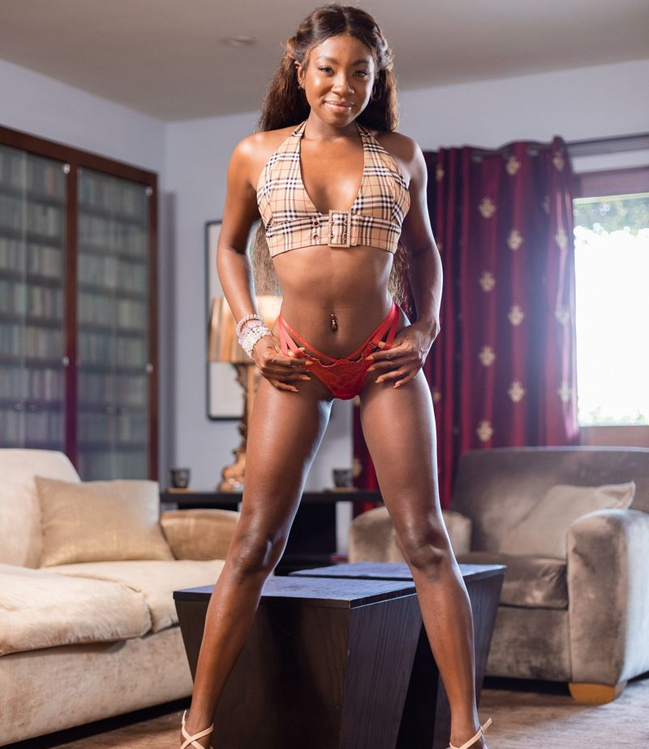
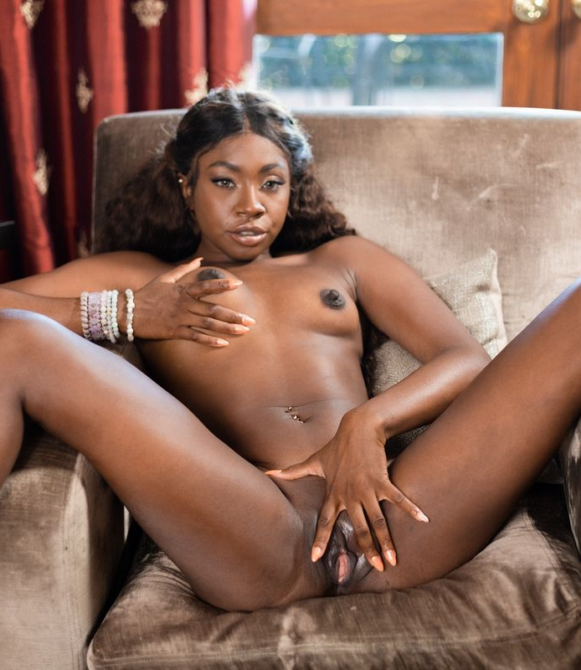
Anne Amari
Age: 26
Height: 170cm
Weight: 51kg
Body Type: Slim
Cup size: 32A
Boobs: Natural
Ethnicity: Black
Years Active: unknown
Rating: 00
The Babes list
List of The Best Sluts in Porn

Slide 6
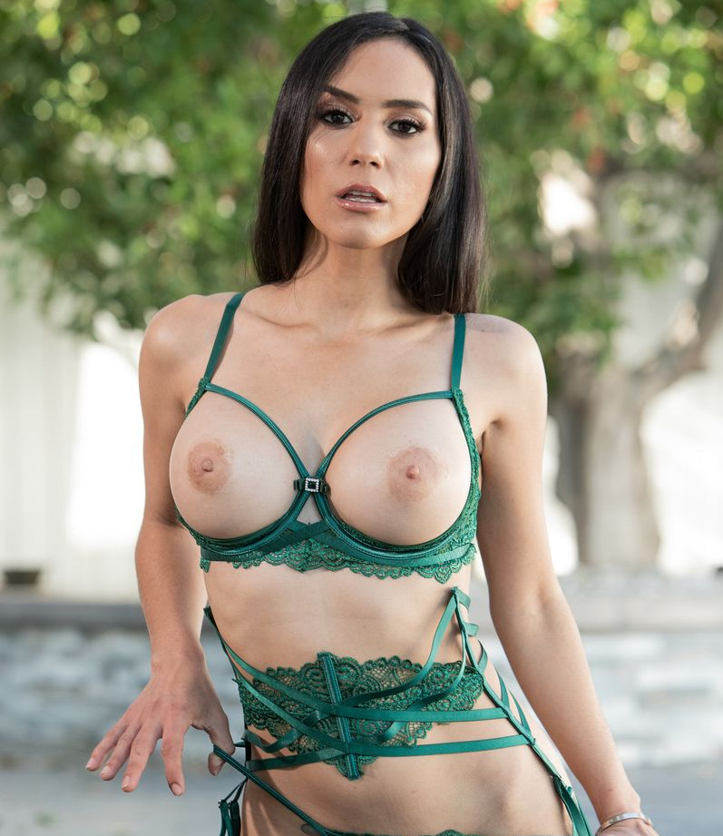
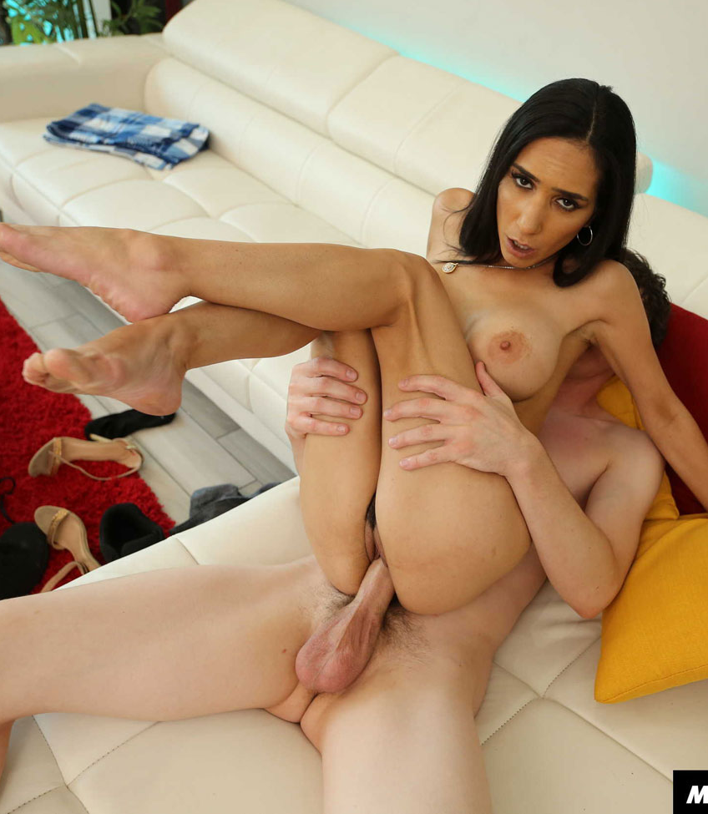
Tia Cyrus
aka Evelyn Everhard
Age: 31
Height: 152cm
Weight: 41kg
Body Type: Slim
Cup size: 32E
Boobs: Enhanced
Ethnicity: Latin
Years Active: unknown
Rating: 00
The Babes list
List of The Best Sluts in Porn

Slide 7
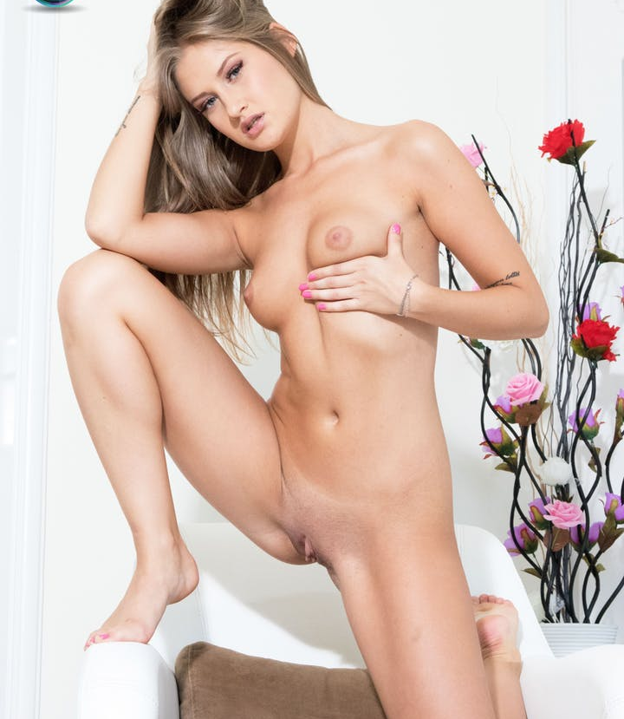
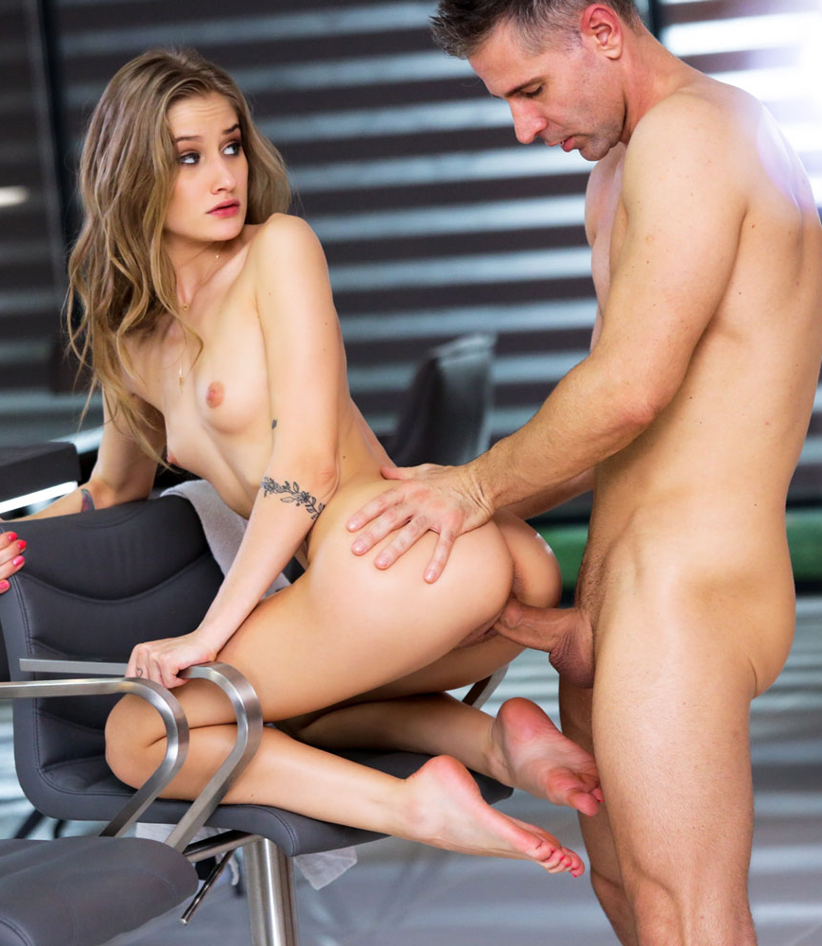
Tiffany Tatum
aka Enzio Ricci
Age: 24
Height: 165cm
Weight: 43kg
Body Type: Slim
Cup size: 34A
Boobs: Natural
Ethnicity: Caucasian
Years Active: 2017-Present
Rating: 00
The Babes list
List of The Best Sluts in Porn

Slide 8
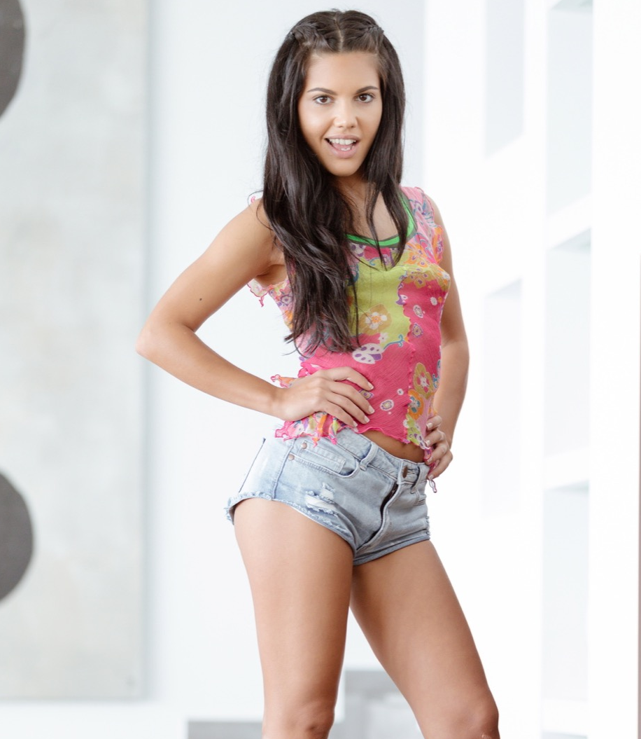
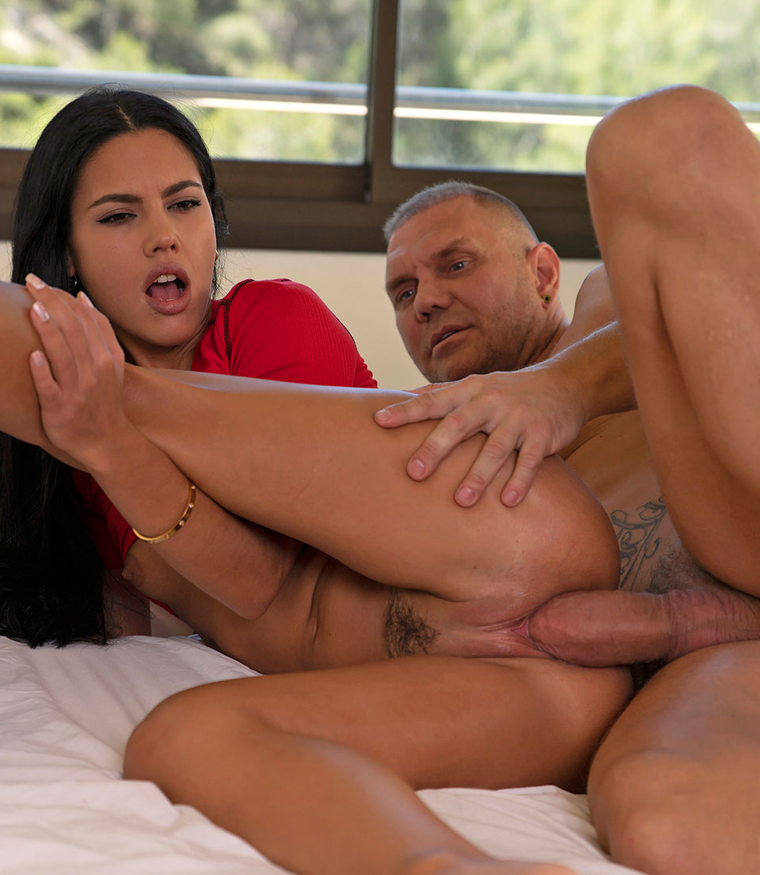
Apolonia Lapiedra aka Apolonia
Age: 29
Height: 157cm
Weight: 46kg
Body Type: Slim
Cup size: 32A
Boobs: Natural
Ethnicity: Caucasian
Years Active: 2015-Present
Rating: 00
The Babes list
List of The Best Sluts in Porn

Slide 9
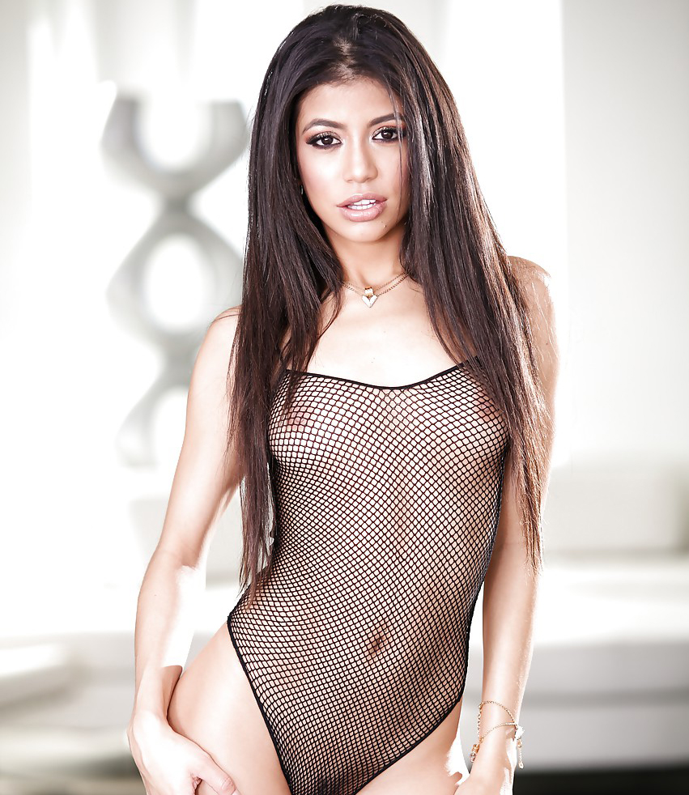
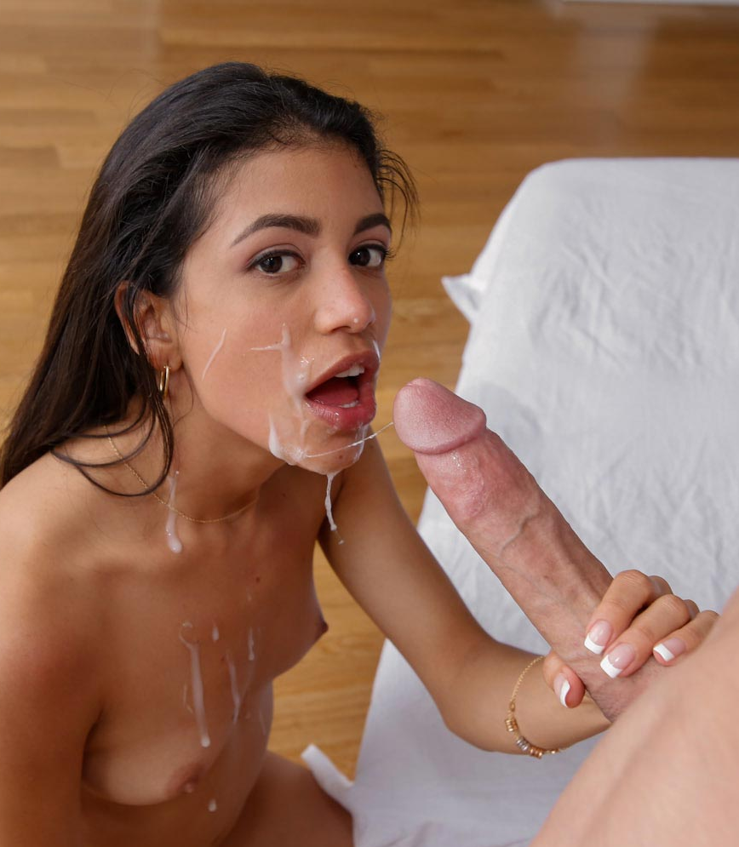
Veronica Rodriguez
aka Barbie Bree
Age: 28
Height: 154cm
Weight: 43kg
Body Type: Average
Cup size: 32B
Boobs: Natural
Ethnicity: Latin
Years Active: 2011-Present
Rating: 00
The Babes list
List of The Best Sluts in Porn

Slide 10
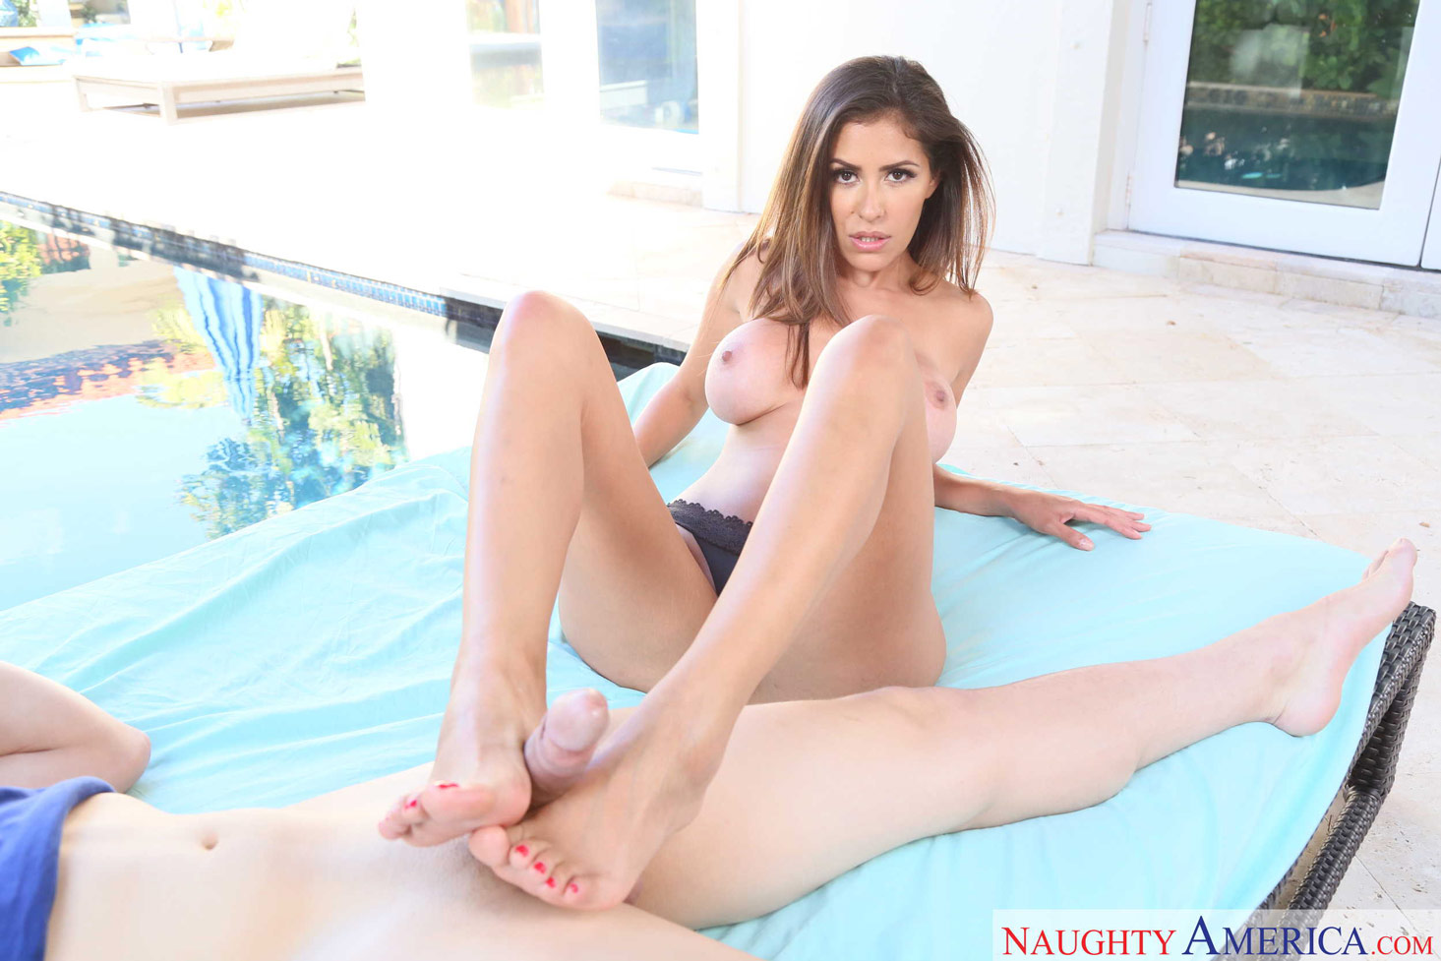
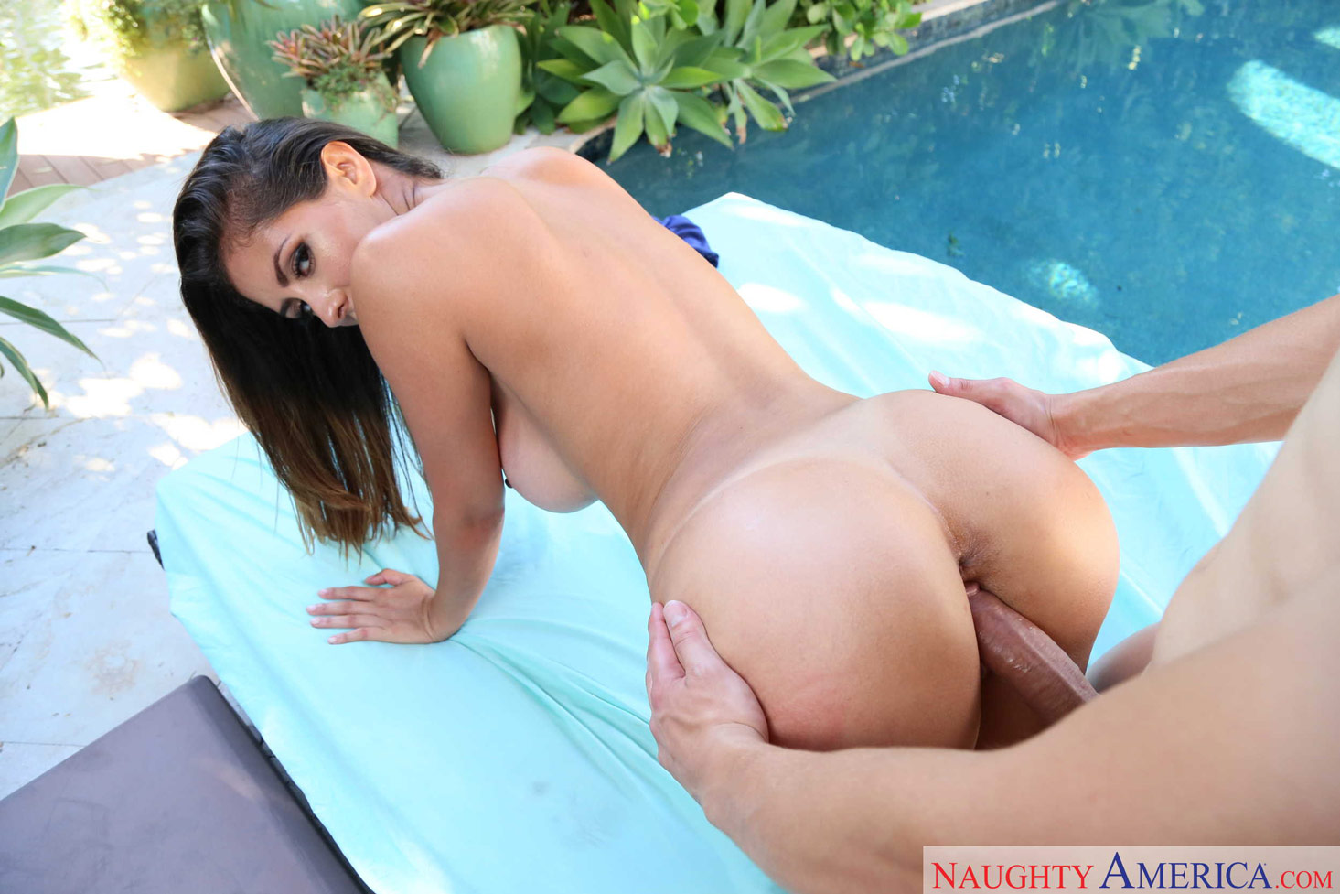
Alexa Vega aka Alexa PenaVega / Alexxa Vega
Age: 32
Height: 154cm
Weight: unknown
Body Type: Average
Cup size: 32D
Boobs: Enhanced
Ethnicity: Latin
Years Active: 2018-Present
Rating: 00
The Babes list
List of The Best Sluts in Porn

Slide 11
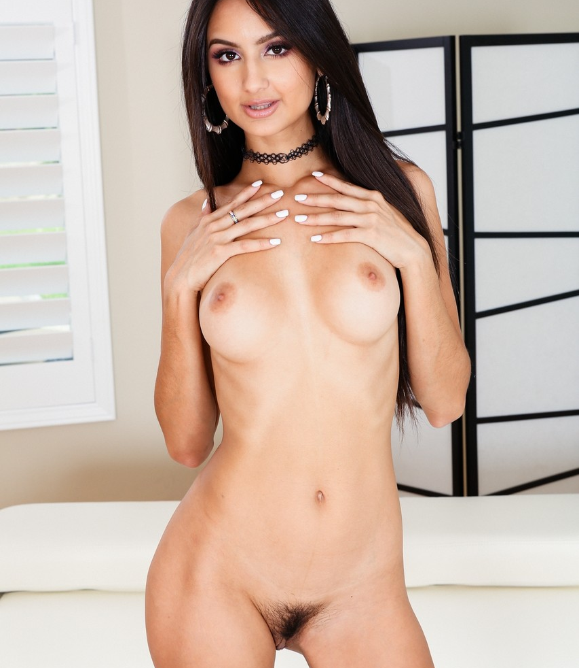
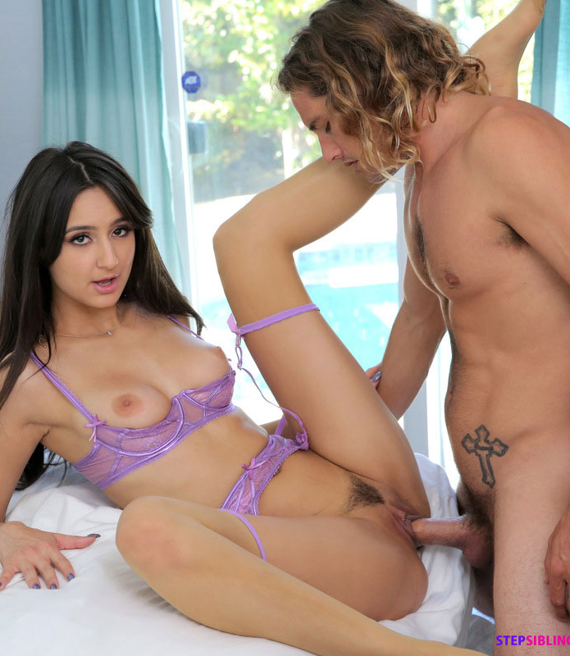
Eliza Ibarra
Age: 24
Height: 177cm
Weight: 57kg
Body Type: Slim
Cup size: 32C
Boobs: Natural
Ethnicity: Latin
Years Active: 2018-Present
Rating: 00
The Babes list
List of The Best Sluts in Porn

Slide 12
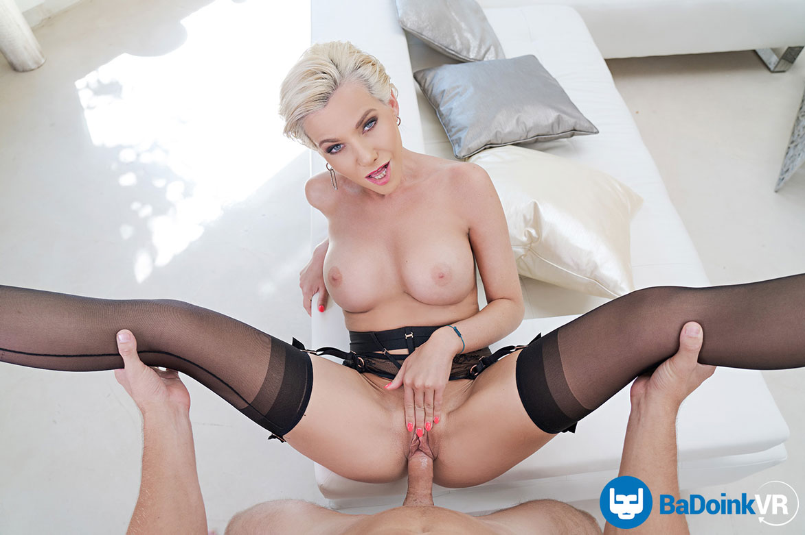
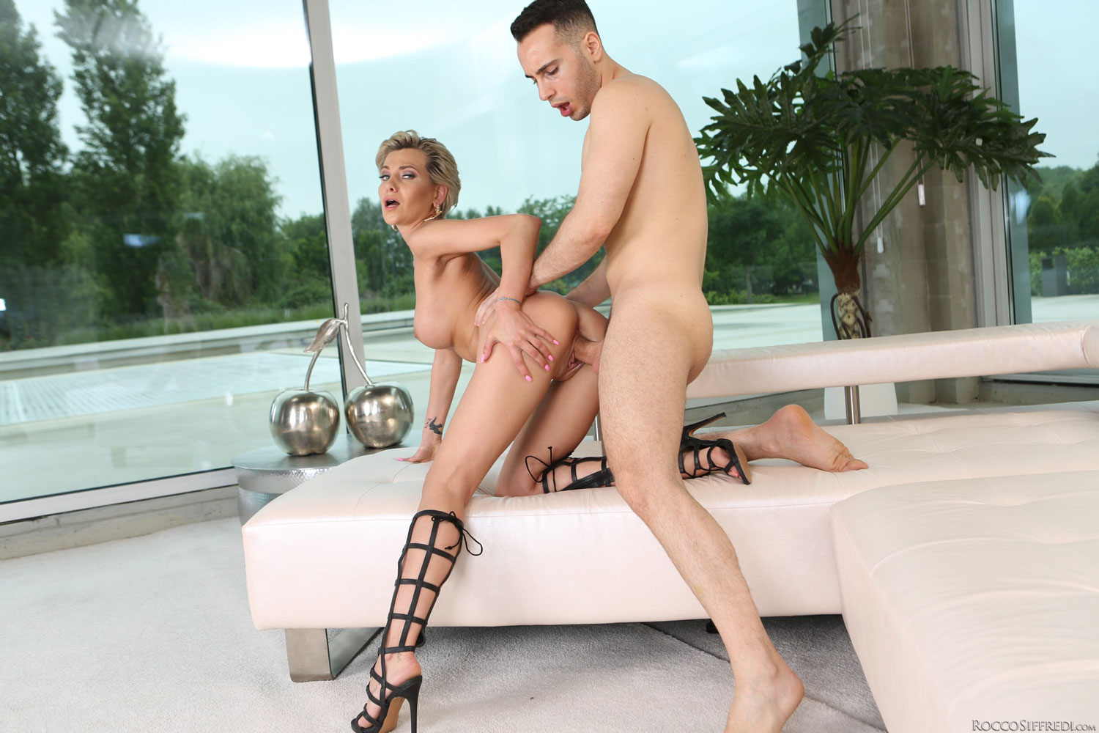
Subil Arch
aka Talina / Tolina / Subie / Sibul / Subil A
Age: 32
Height: 165cm
Weight: 51kg
Body Type: Slim
Cup size: 32E
Boobs: Enhanced
Ethnicity: Caucasian
Years Active: 2012-Present
Rating: 00
The Babes list
List of The Best Sluts in Porn

Slide 13
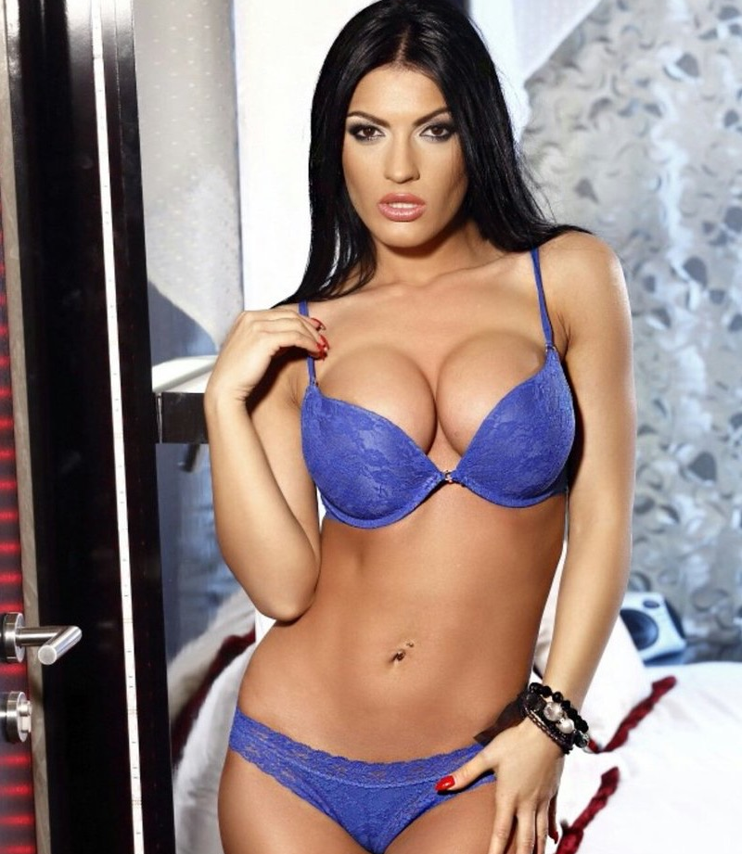
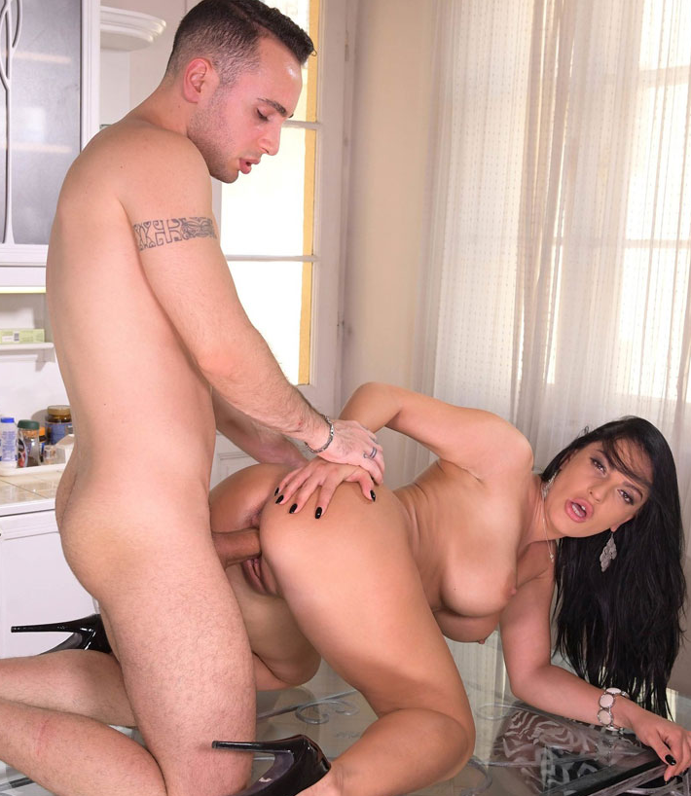
Honey Demon
aka Honey Diamond / Honey Damon
Age: 29
Height: 165cm
Weight: 52kg
Body Type: Slim
Cup size: 34E
Boobs: Enhanced
Ethnicity: Caucasian
Years Active: unknown
Rating: 00
The Babes list
List of The Best Sluts in Porn

Slide 14
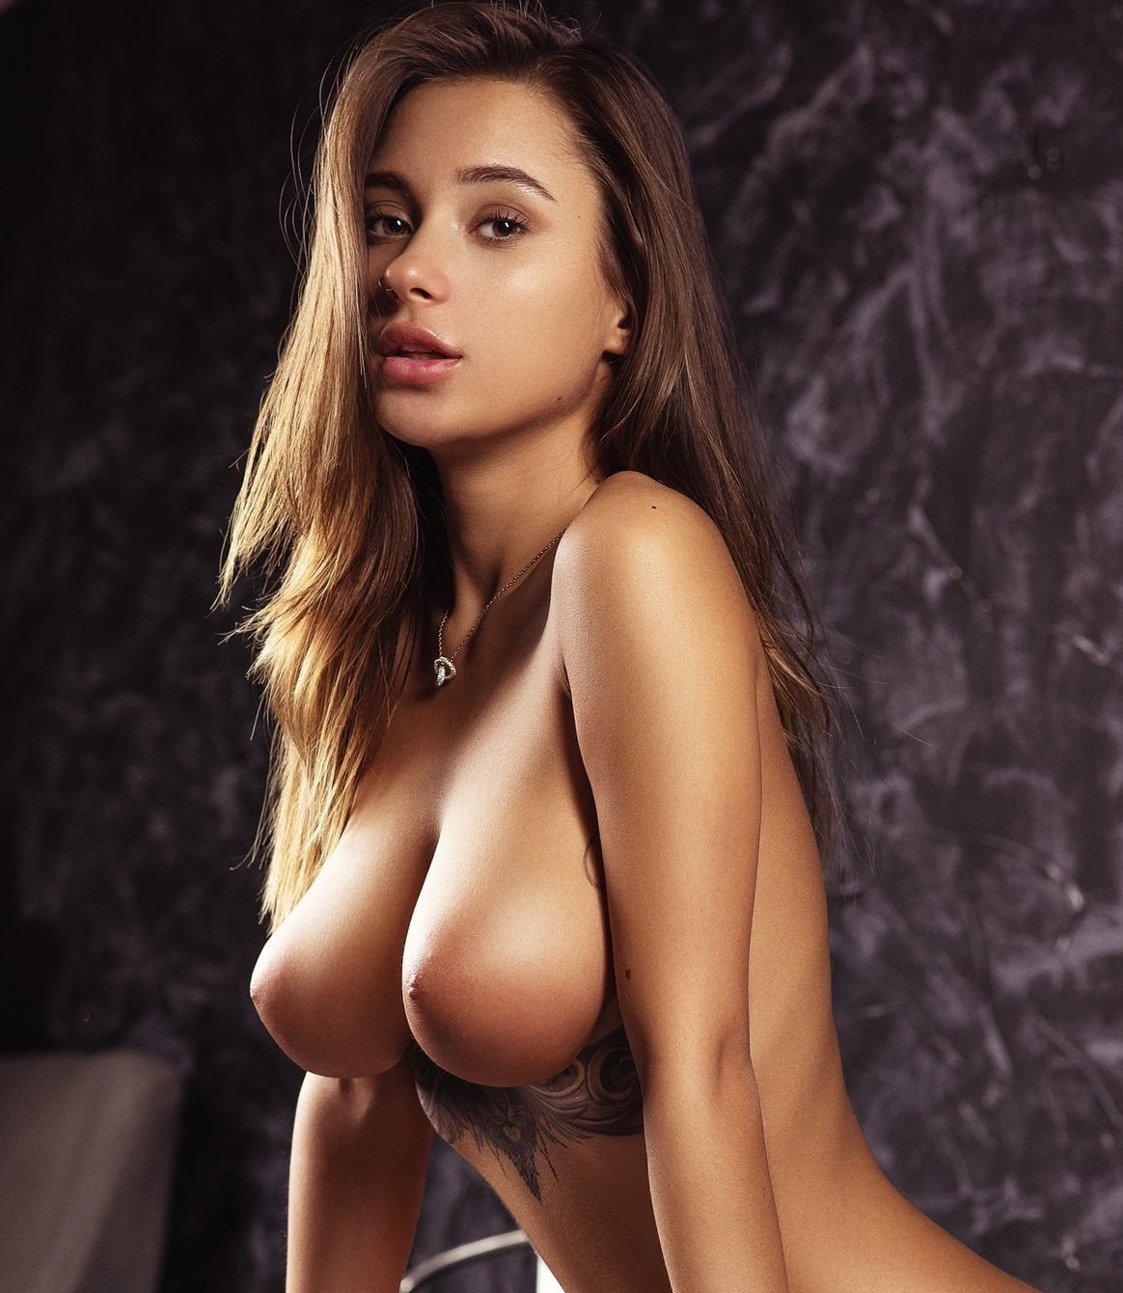
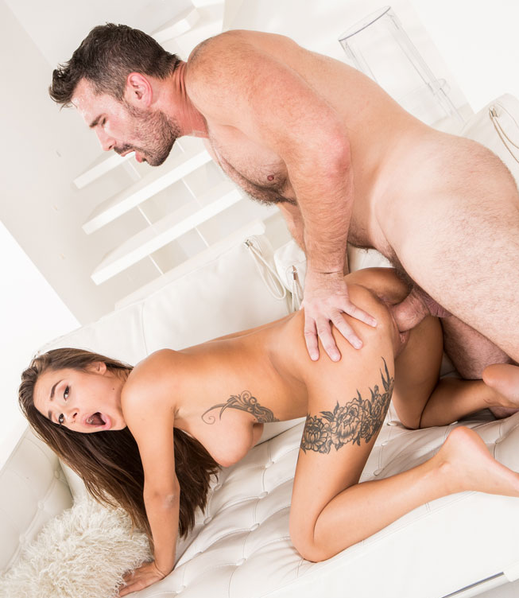
Liya silver
aka Кристина Щербинина / Kristina Shcherbinina / MedinaQ
Age: 22
Height: 162cm
Weight: 50kg
Body Type: Slim
Cup size: 34D
Boobs: Natural
Ethnicity: Caucasian
Years Active: 2018-Present
Rating: 00
The Babes list
List of The Best Sluts in Porn

Slide 15
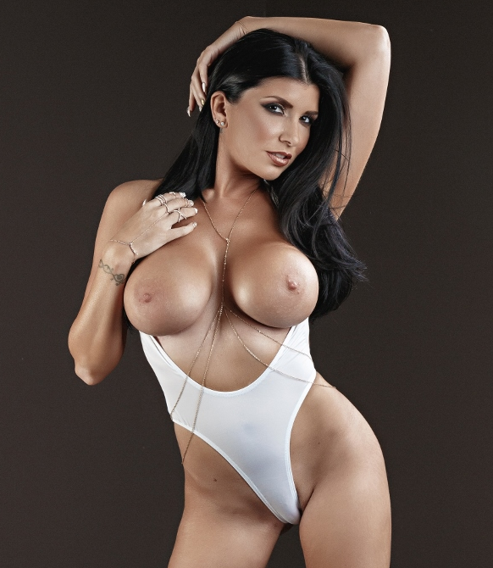
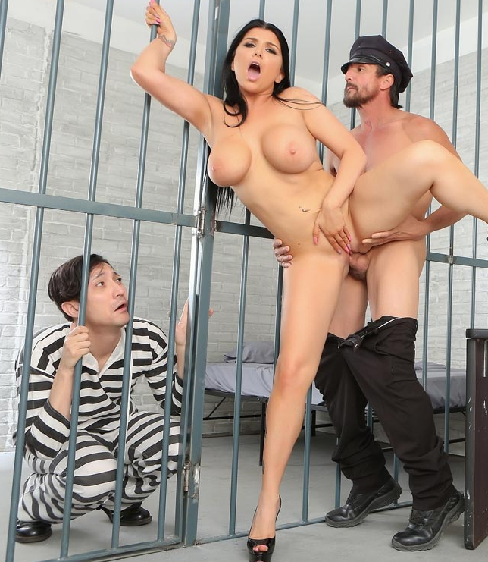
Romi rain
Age: 32
Height: 172cm
Weight: 55kg
Body Type: Average
Cup size: 34D
Boobs: Enhanced
Ethnicity: Caucasian
Years Active: 2012-Present
Rating: 00
The Babes list
List of The Best Sluts in Porn

Slide 16
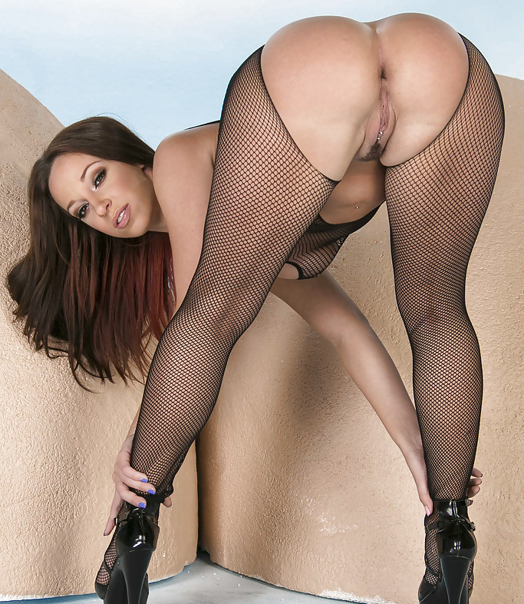
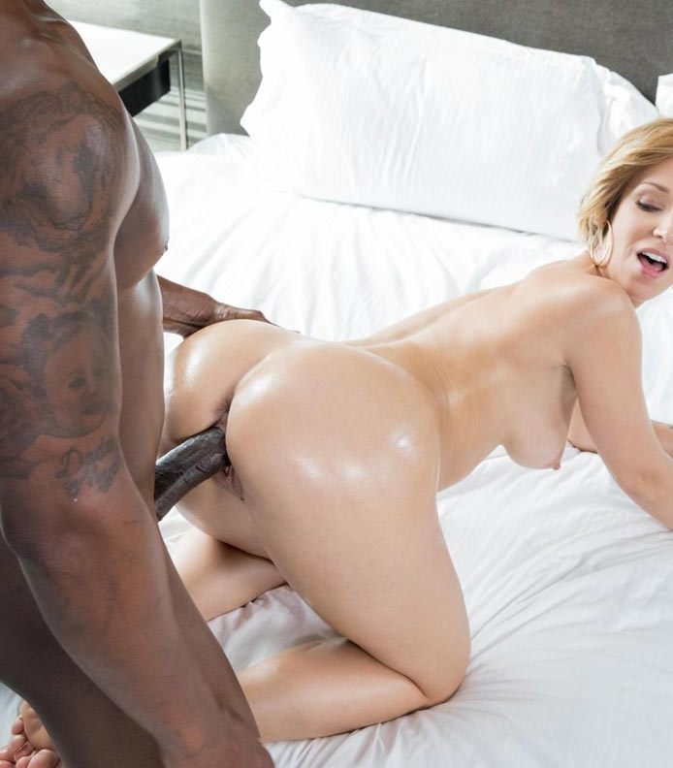
Jada Stevens
aka Jade Stevens / Jacia Stevens / Jayda Stevens
Age: 31
Height: 160cm
Weight: 53kg
Body Type: Average
Cup size: 32C
Boobs: Natural
Ethnicity: Caucasian
Years Active: 2008-Present
Rating: 00
The Babes list
List of The Best Sluts in Porn

Slide 17
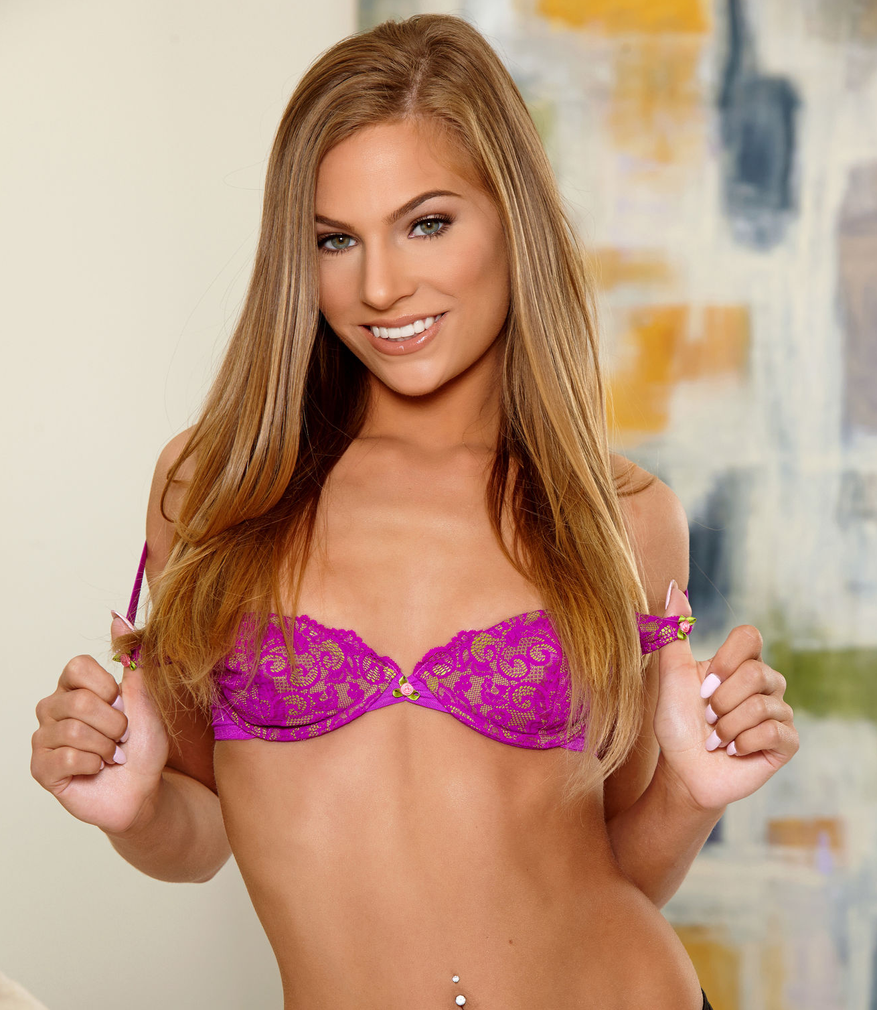
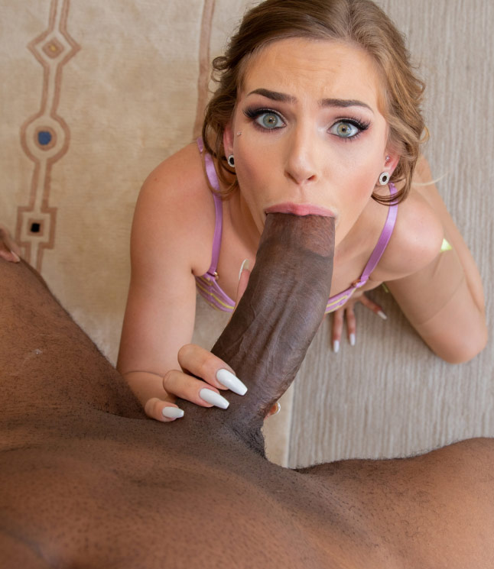
Sydney Cole
Age: 26
Height: 157cm
Weight: 48kg
Body Type: Slim
Cup size: 32B
Boobs: Natural
Ethnicity: Caucasian
Years Active: 2014-Present
Rating: 00
The Babes list
List of The Best Sluts in Porn

Slide 18
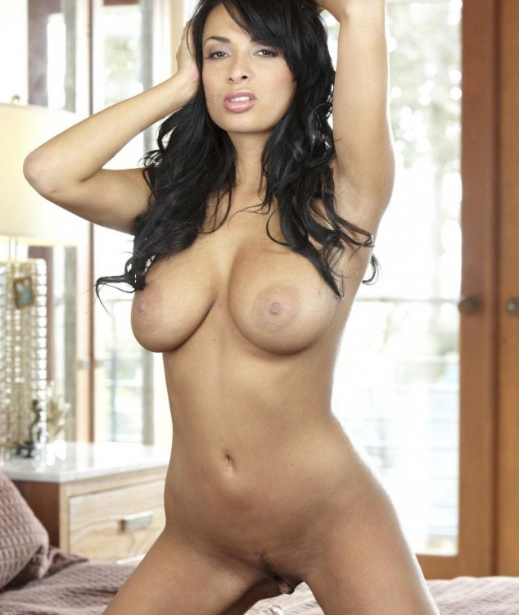
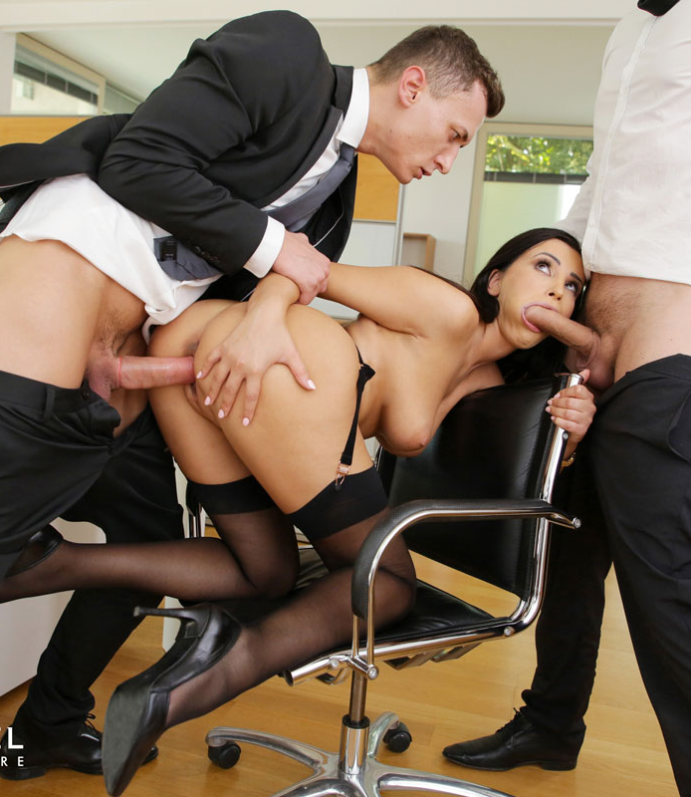
Anissa kate
aka Alissa Kate
Age: 31
Height: 165cm
Weight: 53kg
Body Type: Average
Cup size: 36F (DDD)
Boobs: Natural
Ethnicity: Caucasian
Years Active: 2011-Present
Rating: 00
The Babes list
List of The Best Sluts in Porn

Slide 19
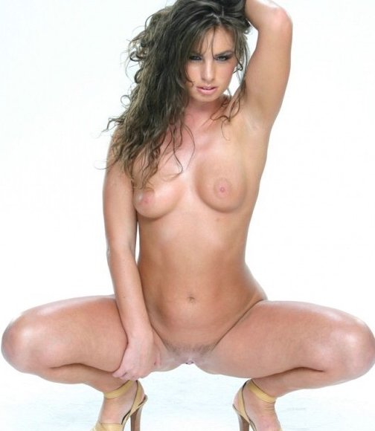
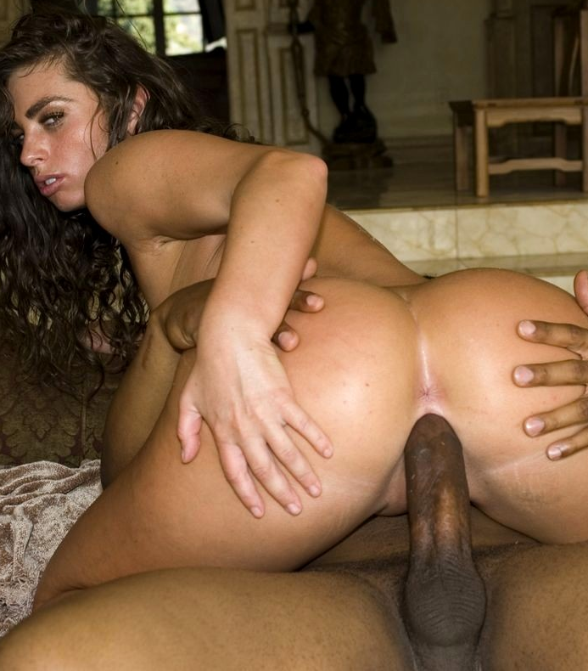
Naomi Russell
aka Naomi Devosh Dechter / Nyomi / Nyomi Russell / Naomi Saint Claire / Naomi St Claire / Mistress Naomi
Age: 38
Height: 170cm
Weight: 59kg
Body Type: Average
Cup size: 32B
Boobs: Natural
Ethnicity: Caucasian
Years Active: 2005-2014
Rating: 00
The Babes list
List of The Best Sluts in Porn

Slide 20


Brenna Sparks
Age: 26
Height: 165cm
Weight: 55kg
Body Type: Average
Cup size: 32C
Boobs: Enhanced
Ethnicity: Asian
Years Active: 2016-Present
Rating: 00
The Babes list
List of The Best Sluts in Porn

Slide 21


Angel Dark
aka Angel A / Angelina Bella / Dark Angel / Kristina Sutalo / Viktoria Cullison / Viktoria Knezova / Viktoria / Angel / Victoria Nova / Zova
Age: 37
Height: 175cm
Weight: 54kg
Body Type: Slim
Cup size: 32D
Boobs: Natural
Ethnicity: Caucasian
Years Active: 2003-2015
Rating: 00
The Babes list
List of The Best Sluts in Porn

Slide 22


Amia Miley
aka Amia Moretti / Amaia Miley / Ami Miley / Ileana FTV / Amaia Moretti / Amea Moretti / Abbey Nubiles
Age: 30
Height: 152cm
Weight: 48kg
Body Type: Slim
Cup size: 32D
Boobs: Enhanced
Ethnicity: Caucasian
Years Active: 2009-Present
Rating: 00
The Babes list
List of The Best Sluts in Porn

Slide 23


Miriama Kunkelova
Miriama Kunkelova
aka Andrea / Kayla / Kaylee / Kaylee J / Kaylie / Kelly / Lola / Lolita / Loraine / Mariama / Mima / Mima A / Mimi / Mina / Mina A / Miranda / Miriam / Miriama / Miriama K / Miriama Kunkelova / Mirka / Mirka Maitland / Mitzi B / Muriel / Nancey / Nancy /
Age: 34
Height: 160cm
Weight: 42kg
Body Type: Slim
Cup size: 32B
Boobs: Enhanced
Ethnicity: Caucasian
Years Active: 2006-2011
Rating: 00
The Babes list
List of The Best Sluts in Porn

Slide 24


Abbie Cat
aka Abbie Karups / Evelin / Abbie / Abbie Sapphic
Age: 31
Height: 170cm
Weight: 54kg
Body Type: Slim
Cup size: 32D
Boobs: Enhanced
Ethnicity: Caucasian
Years Active: 2019-2016
Rating: 00
The Babes list
List of The Best Sluts in Porn

Slide 25


Katrin Wolf
aka Aletta / Aniko Stark / Ildiko / Nasty / Nesty
Age: 37
Height: 154cm
Weight: 45kg
Body Type: Avarage
Cup size: 36B
Boobs: Natural
Ethnicity: Caucasian
Years Active: 2005-Present
Rating: 00
The Babes list
List of The Best Sluts in Porn

Slide 26


Jasmine Caro
aka Daneisy Valdivia
Age: 32
Height: 165cm
Weight: 52kg
Body Type: Average
Cup size: 32E
Boobs: Enhanced
Ethnicity: Middle Eastern
Years Active: 2013-2017
Rating: 00
The Babes list
List of The Best Sluts in Porn

Slide 27


Pristine Edge
aka Jane Doux / Jane Douxxx / Pristine E
Age: 34
Height: 160cm
Weight: 47kg
Body Type: Slim
Cup size: 32D
Boobs: Enhanced
Ethnicity: Caucasian
Years Active: 2014-Present
Rating: 00
The Babes list
List of The Best Sluts in Porn

Slide 28


Azul Hermosa
Age: 29
Height: 170cm
Weight: 57kg
Body Type: Slim
Cup size: 34DDD
Boobs: Enhanced
Ethnicity: Middle Eastern
Years Active: 2020-Present
Rating: 00
The Babes list
List of The Best Sluts in Porn

Slide 29


Kelly Oliveira
Age: 19
Height: 175cm
Weight: unknown
Body Type: Average
Cup size: 36DD
Boobs: Enhanced
Ethnicity: Latin
Years Active: unknown
Rating: 00
The Babes list
List of The Best Sluts in Porn

Slide 30


Patty Michova
Age: 28
Height: 165cm
Weight: 57kg
Body Type: Average
Cup size: 32F
Boobs: Enhanced
Ethnicity: Caucasian
Years Active: 2014-Present
Rating: 00
The Babes list
List of The Best Sluts in Porn

Slide 31


Peta Jensen
aka Scarlett Reid
Age: 28
Height: 170cm
Weight: 57kg
Body Type: Average
Cup size: 34F
Boobs: Enhanced
Ethnicity: Caucasian
Years Active: 2014-Present
Rating: 00
The Babes list
List of The Best Sluts in Porn

Slide 32


Charity Crawford
Age: 23
Height: 177cm
Weight: 54kg
Body Type: Slim
Cup size: 32B
Boobs: Natural
Ethnicity: Caucasian
Years Active: 2017-Present
Rating: 00
The Babes list
List of The Best Sluts in Porn

Slide 33


Shaiden Rogue
Age: 20
Height: 177cm
Weight: 52kg
Body Type: Athletic
Cup size: 34A
Boobs: Natural
Ethnicity: Caucasian
Years Active: 2019-Present
Rating: 00
The Babes list
List of The Best Sluts in Porn

Slide 34


Nancy Ace
aka Nancy / Nancy A / Nancy Anastasiia / Nancy Y / Nancy A MetArt / Nancy Karl / Nancy Photodromm / Allie / Erika / Jane F
Age: 27
Height: 165cm
Weight: 45kg
Body Type: Slim
Cup size: 32C
Boobs: Natural
Ethnicity: Caucasian
Years Active: 2014-Present
Rating: 00
The Babes list
List of The Best Sluts in Porn

Slide 35


Victoria June
aka Victoria Vice
Age: 25
Height: 161cm
Weight: 47kg
Body Type: Average
Cup size: 34E
Boobs: Enhanced
Ethnicity: Latin
Years Active: 2017-Present
Rating: 00
The Babes list
List of The Best Sluts in Porn

Slide 36


Scarlit Scandal
aka Skarlitt Scandal
Age: 22
Height: 154cm
Weight: 45kg
Body Type: Slim
Cup size: 32B
Boobs: Natural
Ethnicity: Black
Years Active: 2019-Present
Rating: 00
The Babes list
List of The Best Sluts in Porn

Slide 37


Anya Ivy
Age: 29
Height: 157cm
Weight: 49kg
Body Type: Average
Cup size: 36D
Boobs: Natural
Ethnicity: Black
Years Active: unknown
Rating: 00
The Babes list
List of The Best Sluts in Porn

Slide 38


Demi Sutra
aka Ajaa / Ajaa Xxx / Demi Dolce
Age: 27
Height: 160cm
Weight: 50kg
Body Type: Slim
Cup size: 32D
Boobs: Enhanced
Ethnicity: Black
Years Active: 2015-Present
Rating: 00
The Babes list
List of The Best Sluts in Porn

Slide 39


Sarah Banks
Age: 24
Height: 152cm
Weight: 45kg
Body Type: Athletic
Cup size: DD
Boobs: Enhanced
Ethnicity: Black
Years Active: 2016-Present
Rating: 00
The Babes list
List of The Best Sluts in Porn

Slide 40


September Reign
Age: 31
Height: 162cm
Weight: 47kg
Body Type: Slim
Cup size: 34D
Boobs: Enhanced
Ethnicity: Black
Years Active: unknown
Rating: 00
The Babes list
List of The Best Sluts in Porn

Slide 41


Darcia Lee
Darce Lee / Darcee Lee / Dadlee Lee
Age: 23
Height: 157cm
Weight: 55kg
Body Type: Average
Cup size: 34D
Boobs: Enhanced
Ethnicity: Caucasian
Years Active: 2017-Present
Rating: 00
The Babes list
List of The Best Sluts in Porn

Slide 42


Gia Milana
aka shay evans/ Cherokee Neal
Age: 30
Height: 152cm
Weight: 48kg
Body Type: Slim
Cup size: 34D
Boobs: Enhanced
Ethnicity: Latin
Years Active: 2015-Present
Rating: 00
The Babes list
List of The Best Sluts in Porn

Slide 43
The Babes list
List of The Best Sluts in Porn
by Erez Naim

Slide 44
Anna Amari
Khloe Kapri
Veronica Leal
Tia Cyrus
Tiffany Tatum
Kali Rose
Apolonia Lapiedra –
Veronica Rodriguez –
Alexa Vega
Eliza Ibarra
Subil Arch
Honey daemon
Liya silver
Romi rain
Jada Stevens
Sydney Cole
Anissa kate
Naomi Russel
Brenna Spark
Angel Dark
Amia Miley
Miriama Kunkelova
Abbie Cat
Katrin Wolf
Spice Jasmine
Caro Mila Garcia
Azul hermosa
Pristine edge
Kelly Oliveira
Patty Michova
Peta Jensen
Charity Crawford
Shaiden Rogue
Nancy A
Victoria June
Scarlit scandal
Anya ivy
Demy sutra
Sarah banks
Reign September
Darcia Lee
Gia Milano

